Slide 1
Project Planning and Monitoring

Slide 2
Project Change Management
Project Change Management - a general term describing the procedures used to ensure that changes are introduced in a controlled and coordinated manner.
Change Request – Requests to expand or reduce the project scope, modify policies, processes, plans or procedures, modify costs or budgets, or revise schedules.
Change Order – Used in some companies to identify approved change requests (change request when the request is made and change order once it has been approved)
Project Controlling and Monitoring

Slide 3
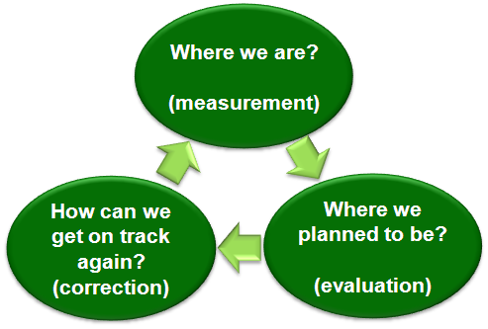
What is Project Change Management?
Project change management encompasses all of the processes necessary to determine where you are at compared to where you planned to be and the activities required to get back on track if those are not aligned
Project Controlling and Monitoring
Notes:
Estimating: approximation of costs
Budgeting: aggregating the estimated costs of individual activities or work pkgs to establish a cost baseline
Control: influencing the factors that create cost variances and control changes to budget

Slide 4
Why is Project Change Management Important?
Projects seldom run exactly according to plan. Project deliverables must be maintained by carefully and continuously managing changes, either by rejecting changes or by approving changes so those approved changes are incorporated into a revised baseline
Enables the project team to identify potential problems in a timely manner and take corrective action, when necessary, to control the execution of the project
Ensures the project team and stakeholders have an accurate understanding of what has been completed in the project to-date and what will be delivered in total
Project Controlling and Monitoring
Notes:
Planning – which quality standards are relevant and determine how to satisfy them
QA – applying the planned quality activities to ensure quality requirements are met
QC – monitor project results to determine if they comply to quality standards, ID way to eliminate causes of unsatisfactory performance.

Slide 5
Actual vs Planned
Determining where you are vs. where you planned to be:
  Requires project details be documented and approved
    Documented scope, cost, time, quality, people, other (eg. Charter)
    Documented details of product / service functionality (eg. Requirements Document)
  Requires processes and tools to assess performance to determine whether any corrective or preventative actions are indicated, and then recommending those actions as necessary
    Scope and requirements verification throughout the project
    Budget tracking and forecasting
    Task duration tracking
    Overall project timeline tracking & verification
Project Controlling and Monitoring
Notes:
Plan – what to purchase, when and how
Contract Planning: Document products, services and results requirement and and ID potential sellers
RFI, RFP, RFQ
Admin – manage the contract
Closure – settle each contract, close

Slide 6
Getting Back on Track
How can we get on track again?
  Identify that a change needs to occur or has occurred
  Document the complete impact of requested changes
  Follow approved processes for documenting and approving requested changes
  Maintain the integrity of baselines by releasing only approved changes for incorporation into project products or services, and maintaining their related configuration and planning documentation
  Control and update the scope, cost, budget, schedule and quality requirements based upon approved changes, by coordinating changes across the entire project
  Influence the factors that circumvent integrated change control so that only approved changes are implemented
Notes:
Develop: improve competencies and interaction of team members to enhance project performance
Manage: track performance, provide feedback, resolve issues

Slide 7
Perform Integration Change Control
Perform integration change control is the process of reviewing all change requests, approving changes and managing changes to the deliverables, organizational process assets, project documents and the project management plan.

Slide 8
Change management activities
Perform Integration Change Control includes following change management activities:
  Influence factors that avoid change control
  Review, analyse and approve promptly
  Manage approved changes
  Maintain integrity of baselines
  Review, approve or deny recommended actions
  Coordinate changes across entire project
  Document impact of changes

Slide 9
Verify Scope
Verify scope is the process of formalizing acceptance of completed project deliverables. It includes:
  Reviewing deliverables with customer
  Obtaining formal acceptance
Differs from quality control since quality control is concerned with correctness of deliverables whereas verify scope with acceptance.
Done by inspection.

Slide 10
Control Scope
Process of monitoring status of project scope and managing changes to scope baselines.
Ensures all recommended actions are processed through perform integration change control process.
Variance analysis.
Project Controlling and Monitoring

Slide 11
Control Schedule
Control schedule is the process of monitoring status of project to update project progress and manage changes to schedule baseline.
Tools and techniques involved are:
  Performance review
  Variance analysis
  Project management software
  Resource levelling
  What-if scenario analysis
  Adjusting leads and lags
  Schedule compression
  Scheduling tool
Project Controlling and Monitoring

Slide 12
Resource Levelling
Critical path method calculates theoretical early, late start and finish dates for activities regardless of resource limitation.
Resource levelling is used when shared or critical required resources are available at certain times in limited quantity or to keep resource usage at constant level.
Project Controlling and Monitoring

